Slide 1


OLER
Your key to sleep free driving

Slide 2

MISSION STATEMENT
We thrive to provide a robust machine learning based tool that will be easily integrable and has a potential to save many lives.

Slide 3
ABOUT OUR COMPANY
OLER is a automotive-ML based startup offering simple solution to detect drowsy person. Our product employs eye detection algorithm & CNN-based model for classification, providing accurate and cost-effective way to detect drowsy person.
Easily accessible
Flexible
Fast

Slide 4
WHO ARE WE ?
Team of passionate engineers with the thought to contribute to the advancement of human civilization and revolutionize the world.
We believe in saving lives, and our product performs it effectively.

Slide 5
PROBLEM
Drivers who do not take regular breaks when driving long distances run a high risk of becoming drowsy, leading to:
Loss of control over the vehicle
Increase in the probability of accidents

Slide 6

SOLUTION
Built a model that detects and sets off an alarm if a person is on the verge of falling asleep.

Slide 7
HOW IT WORKS?
Our product,
Takes real-time images
Uploads it to server
Model performs feature extraction
Classifies and then predicts if the user is drowsy

Slide 8



WHAT DO WE DO?
Ensure safety of:
Driver
Pedestrians
Passengers

Slide 9
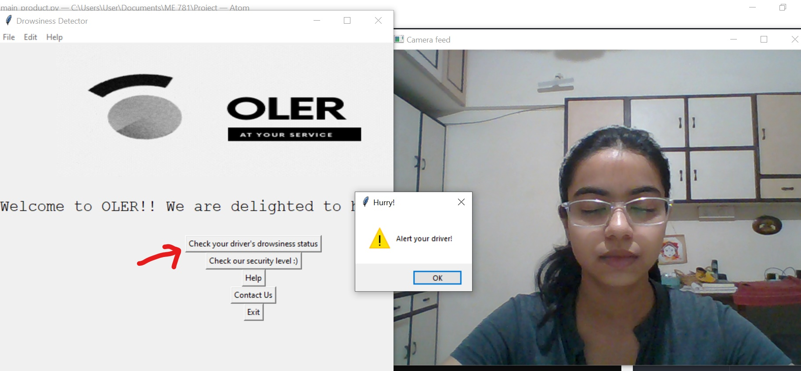
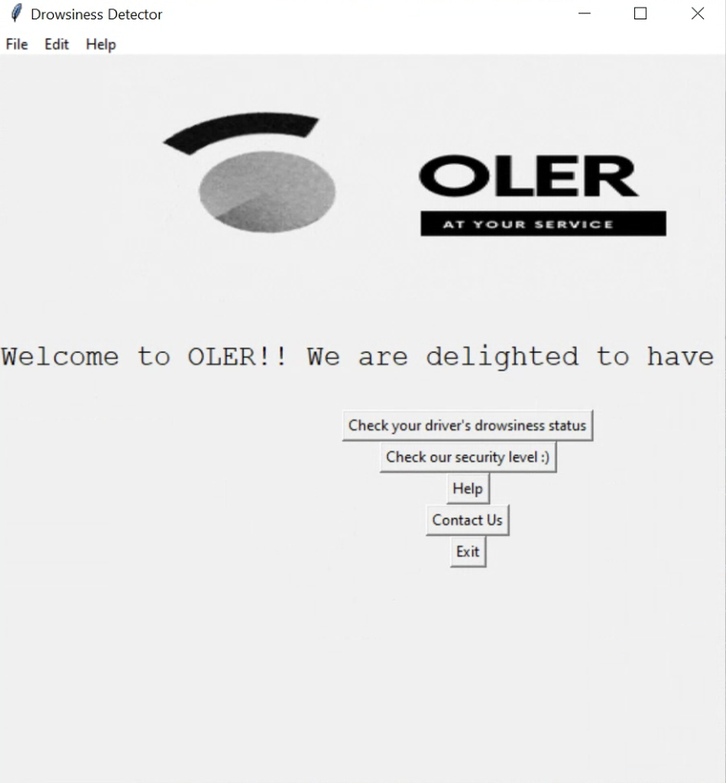
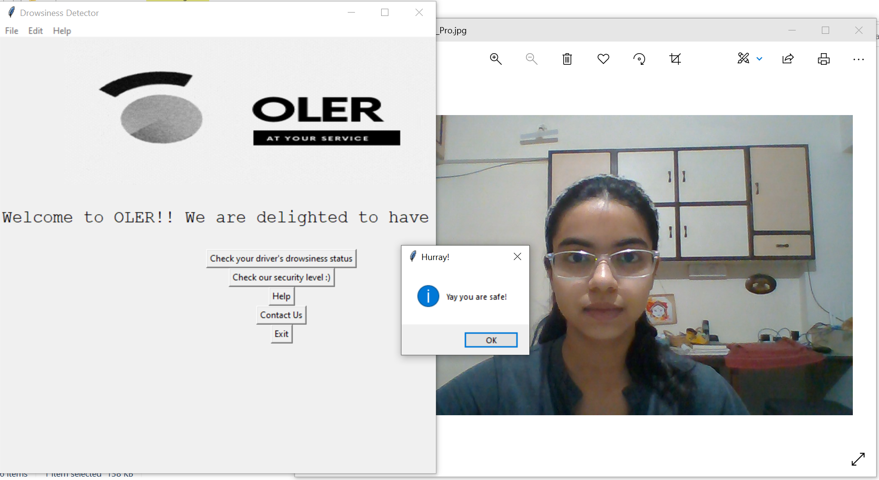
PRODUCT AT
A GLANCE

Slide 10
Fast & Accurate:
Model 96% accurate
UNIQUE
SELLING POINT
Highly Automated:
Less human interaction
Flexible:
One code for several applications

Slide 11



TARGET CLIENTS

Slide 12
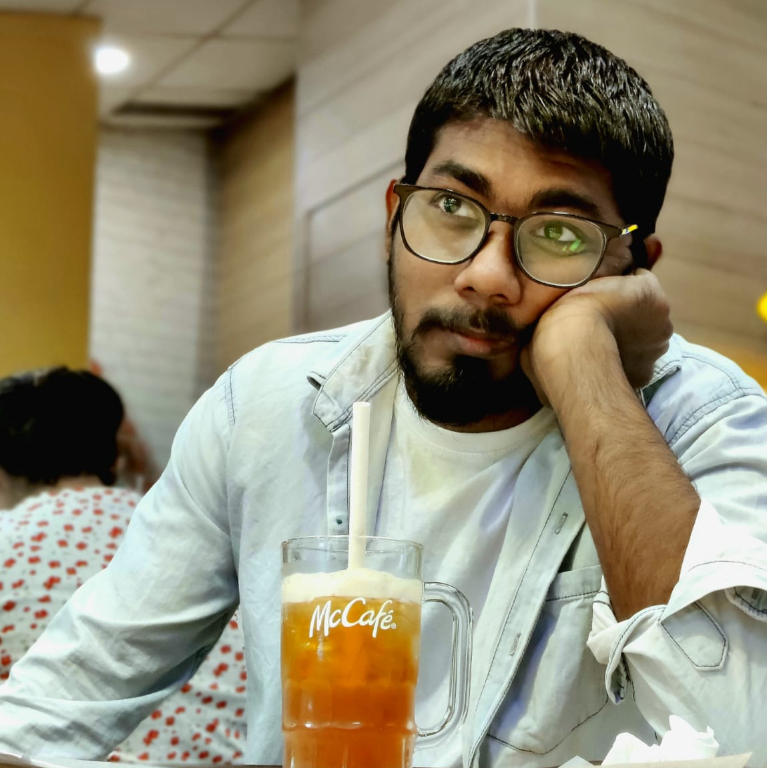
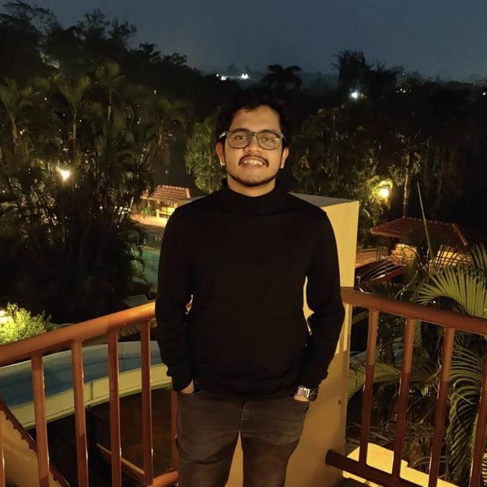
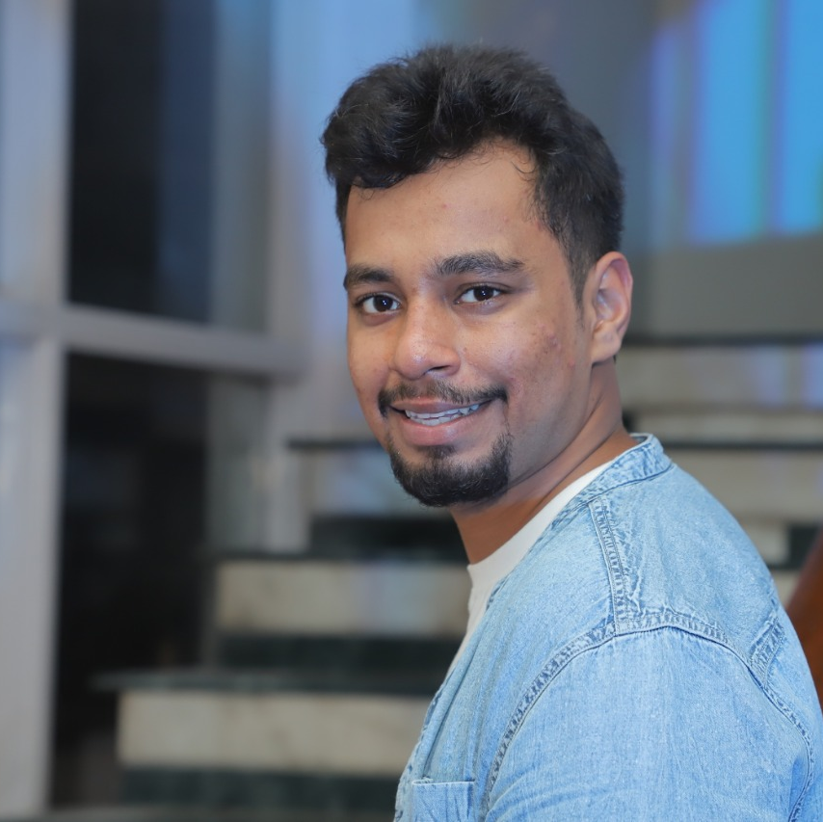

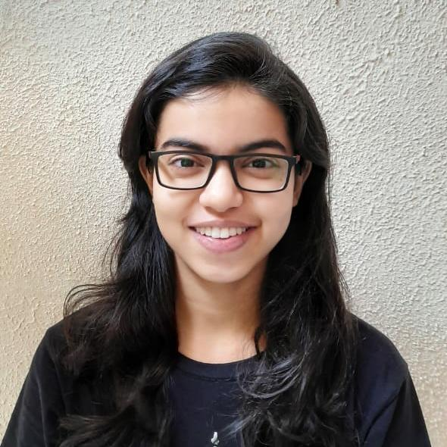
OUR TEAM
Prakash Singh Co-Founder & CEO OLER | Shourish Khade Co-Founder & CTO OLER | Ritu Raj Co-Founder & CTO OLER | Killa Anil Kumar Co-Founder & CFO OLER | Mukta Wagle Co-Founder & CTO OLER

